Slide 1
Unit V
Wireless systems and standards
Week 1 AMPS Voice modulation Process, GSM system architecture and its interfaces, GSM frame structure, GSM speech operations input - output,
Week 2 Forward CDMA process, Reverse CDMA Process, Multicarrier modulation, OFDM Transmitter Block diagram
Week 3 OFDM Receiver Block diagram, Importance of Cyclic Prefix, Case study - Modern antennas, Case study - Modern antennas
References:
William Stallings, "Wireless Communication & Networking", Pearson Education Asia, 2009
Rappaport.T.S, “Wireless Communications:Principles and Practice”
Only for study purpose and These slides contains copyrighted materials from - Wireless Communications: Principles and Practice, Theodore S. Rappaport, used as instructor resources.

Slide 2
WEEK 1
AMPS Voice modulation Process, GSM system architecture and its interfaces, GSM frame structure, GSM speech operations input - output
References:
William Stallings, "Wireless Communication & Networking", Pearson Education Asia, 2009
Rappaport.T.S, “Wireless Communications:Principles and Practice”

Slide 3
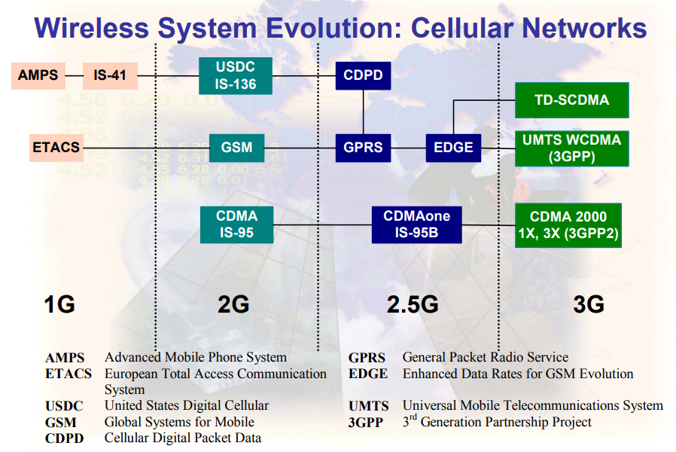

Slide 4
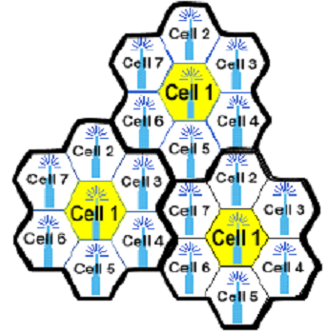
First Generation Systems
Cellular concept emerges in early 1970s.
Cellular technology allows frequency-reuse. With this we need to have Handoff (handover)
In 1G we had analog voice but Control Link was digital

Slide 5
First Generation – AMPS and European Total Access Cellular System (ETACS)
Parameter | AMPS | ETACS
Multiple Access | FDMA | FDMA
Duplexing | FDD | FDD
Channel Bandwidth | 30kHz | 25kHz
Traffic Channel per RF Channel | 1 | 1
Reverse Channel Frequency | 824 – 849 MHz | 890 – 915 MHz
Forward Channel Frequency | 869 – 894 MHz | 935 – 960 MHz
Voice Modulation | FM | FM
Peak Deviation: Voice Channels Control/Wideband Data | ± 12 kHz ± 8 kHz | ± 10 kHz ± 6.4 kHz
Channel Coding for Data Transmission | BCH(40,28) on FC/BCH(48,36) on RC | BCH(40,28) on FC/BCH(48,36) on RC
Data Rate on Control channel | 10kbps | 8kbps
Spectral Efficiency | 0.33 bps/Hz | 0.33 bps/Hz
Number of Channels | 832 | 1000

Slide 6
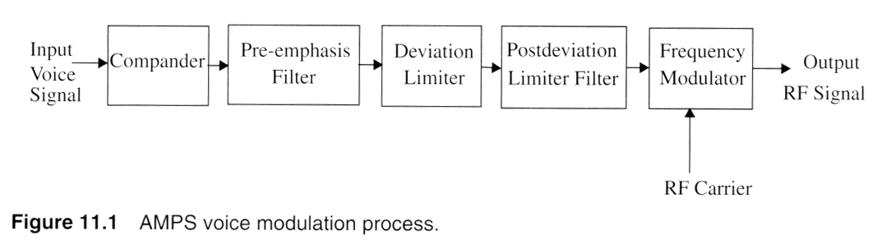
2:1 Compander – accommodate large speech dynamic range, the input signals need to be compressed in amplitude range before modulation. For every 2dB increase in input, 1 dB increase in output (confines the energy to 30 KHz channel B.W).
Pre-emphasis filter – increases the amplitude of high frequency bands and decrease the amplitudes of lower bands.(6 dB/octave high pass response between 0.3 KHz – 3 KHz).
Deviation Limiter (DL) – ensures max freq deviation at the mobile station ± 12 KHz.
Post DL Filter – ensures that the specs on limitations of emission outside the specified band are met, 6 KHz SAT tones.

Slide 7
Global System for Mobile (GSM)

Slide 8
Global System for Mobile (GSM)
GSM ➔ 2nd generation mobile system.
Developed to solve the fragmentation problems of the first cellular systems in Europe.
GSM (Groupe spe'cial mobile) committee specified a common mobile communication system in 900 MHz band.
Renamed the Global System for Mobile Communications for marketing reasons.

Slide 9
GSM Services
◾Telephonic Services
- includes emergency calling and facsimile
◾Bearer Services or Data Services
- Limited to layer 1,2 and 3 of open system interconnection (OSI)reference model.
- Supported services include packet switched protocols and data rates from 300 bps to approx. 9.6 kbps.
◾Supplementary ISDN Services
- Includes call diversion, closed user groups, caller identification, Short Messaging Services (SMS), etc.

Slide 10
Global System for Mobile (GSM)
GSM System Architecture:
Consists of three major interconnected subsystems that interact between themselves.
Base Station Subsystem (BSS) – aka radio subsystem.
Network and Switching Subsystem (NSS)
Operation Support Subsystem (OSS)
Mobile Station (MS) is also a subsystem, but is usually considered to be part of the BSS.

Slide 11
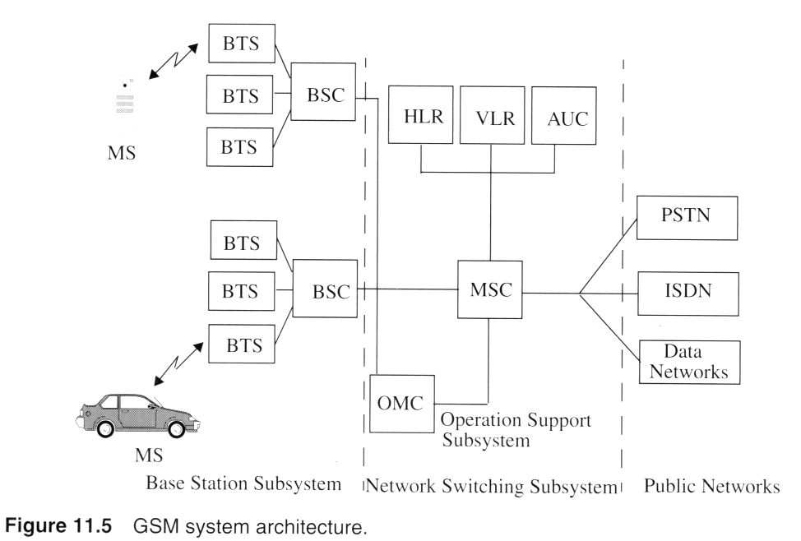
GSM Architecture
Mobile Switching Center (MSC), Base Transceiver Stations (BTS)
Base Station Controllers (BSC) ➔ controls 100s of BTSs.
BTS co-located or remotely distributed and physically connected to the BSC by microwave link or dedicated leased lines.
BSC takes care of handover, reduces load at MSC.
Notes:
Fig. 2.3

Slide 12
Global System for Mobile (GSM)
GSM System Architecture: NSS
Handles the switching of GSM calls between external networks and the BSCs in the radio subsystem.
Responsible for managing and providing external access to several customer databases.
The MSC is the central unit in the NSS and controls the traffic among all of the BSCs.
NSS contains three different data bases:
Home Location Register (HLR)
Visitor Location Register (VLR)
Authentication Center (AUC)

Slide 13
Global System for Mobile (GSM)
GSM System Architecture:
Home Location Register: Contains subscriber information and location information for each user who resides in the same city as the MSC.
International Mobile Subscriber Identity (IMSI) is used to identify the home user.
Visiting Location Register: Temporarily stores the IMSI and customer information for each roaming subscriber who is visiting the coverage area of a particular MSC.
If a roaming mobile is logged in the VLR:
The MSC sends the necessary information to the visiting subscriber's HLR.
So that calls to the roaming mobile can be appropriately routed over the PSTN by the roaming user's HLR.

Slide 14
Global System for Mobile (GSM)
GSM System Architecture:
Authentication Center: A strongly protected database which handles the authentication and encryption keys for every single subscriber in the HLR and VLR.
AUC has Equipment Identity Register (EIR).
EIR indentifies stolen or fraudulently altered phones whose identities are not there in VLR or HLR.

Slide 15
Global System for Mobile (GSM)
GSM System Architecture:
Operation Support Subsystem: Supports one or several Operation Maintenance Centers (OMC).
OMC used to monitor and maintain the performance of each MS, BS, BSC, and MSC within a GSM system.
The OSS has three main functions:
Maintain all telecommunications hardware and network operation.
Manage all charging and billing procedures.
Manage all mobile equipment in the system.

Slide 16
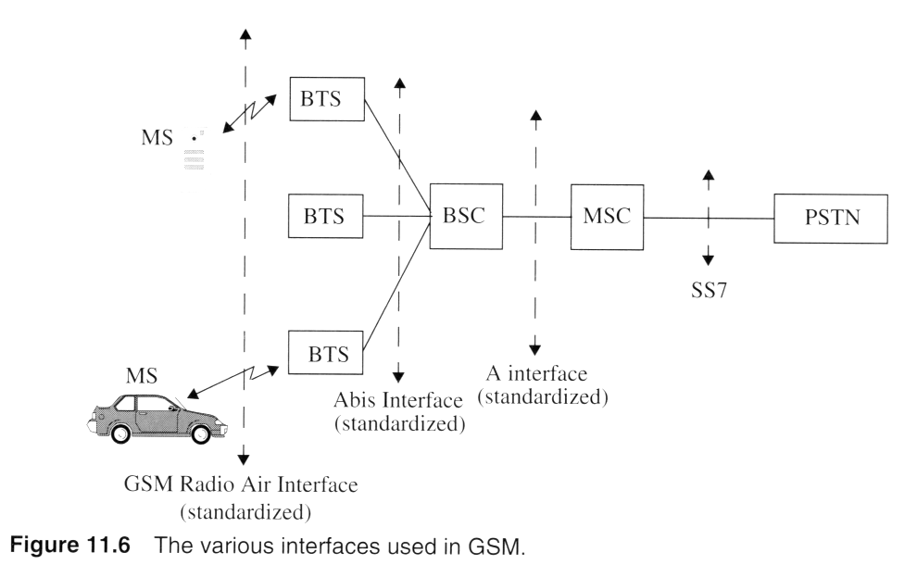
GSM
Abis Interface: Connects a BTS to BSC, carries traffic and maintenance data. Specified by GSM.
A Interface: Interface between a BSC and a MSC, dedicated leased lines or microwave link.
SS7: Network message communication between the MSC, the BSS and MSs.

Slide 17
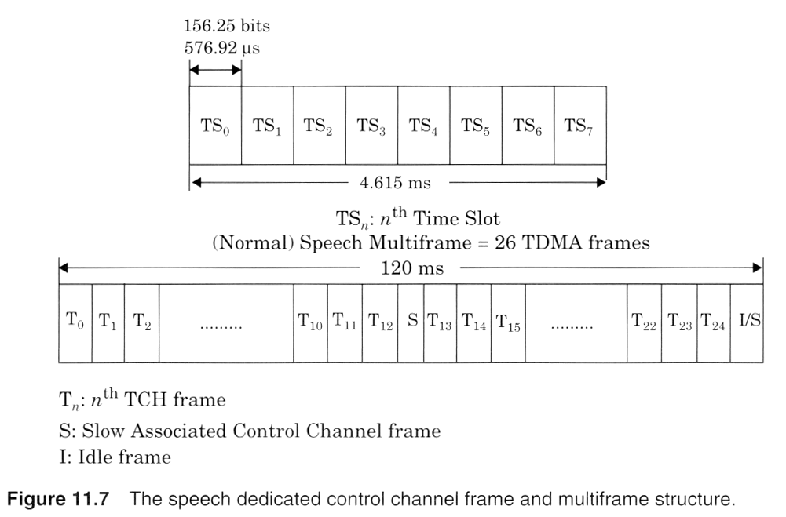
GSM
Notes:
Fig. 2.11

Slide 18
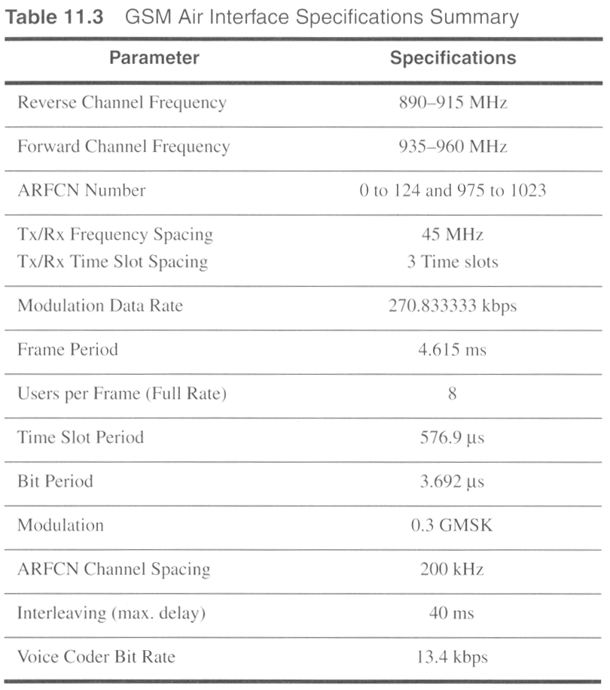
GSM
Notes:
Fig. 2.8

Slide 19
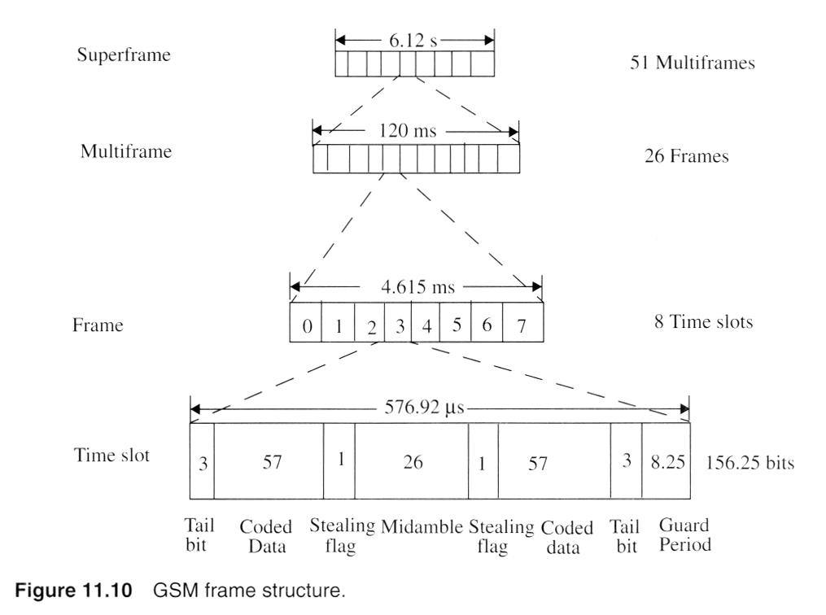
GSM
Notes:
Fig. 2.5

Slide 20
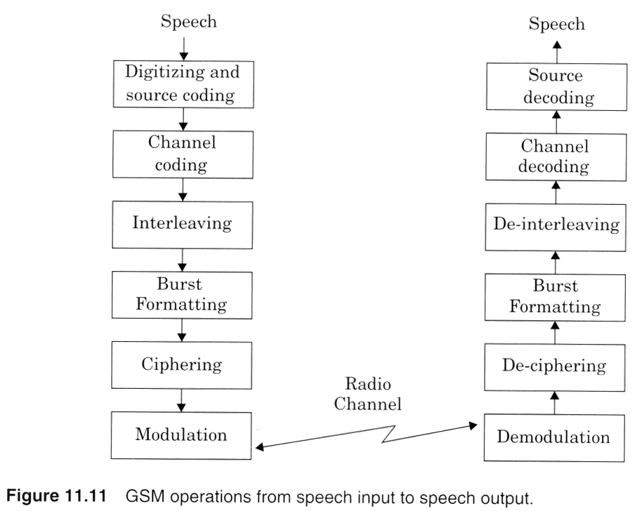
GSM
Notes:
Fig. 2.11

Slide 21
Review Questions
1. What is the cut-off frequency of the baseband. Gaussian, pulse-shaping filter used in the GSM system?
Modulation scheme used by GSM- 0.3 GMSK
Data rate – 270.33 kbps
Cut-off frequency of Gaussian pulse shaping filter is 0.3 x 270.33 =81.25KHz
2. Which of the following is NOT true of GSM? Check all that apply.
(a)The uplink and downlink channels are separated by 45 MHz.
(b) There are eight half-rate users in one timeslot.
(c ) The peak frequency deviation of the GSM modulator is an integer multiple of the GSM data rate.
(d) GSM uses a constant envelope modulation.
Ans- b & c

Slide 22
Review Questions
3. If GSM uses a frame structure where each frame consists of S time slots, and each time slot contains 156.25 bits, and data is transmitted at 270.833 kbps in the channel, find (a) the time duration of a bit, (b) the time duration of a slot,(c) the time duration of a frame, and (d) how long must a user occupying a single time slot must wait between two simultaneous transmissions.
(a) The time duration of a bit, T _{b}= 1/270.833 kbps= 3.692
(b) The time duration of a slot, T _{slot}= 156.25 x T _{b} = 0.577 ms.
(c) The time duration of a frame, T_{f} , = 8 x T _{slot}= 4.615 ms.
(d) A user has to wait 4.615 ms, the arrival time of a new frame, for its next transmission

Slide 23
Review Questions
If a normal GSM time slot consists of 6 trailing bits, 8.25 guard bits, 26 training bits, and 2 traffic bursts of 58 bits of data, find the frame efficiency.
A time slot has 6 + 8.25 + 26 + 2(58) = 156.25 bits.
A frame has 8x 156.25 = 1250 bits/frame.
The number of overhead bits per frame is given by
B _{OH} = 8(6) + 8(8.25) ÷ 8(26) = 322 bits
Thus, the frame efficiency η _{F} = ( 1- (322/1250)) X100= 74.24%

